Slide 1
Concluding The Interview
Pub 4012 Tab N
Notes:
1

Slide 2
TW – Finalizing Return
Pub 4012 Tab O
Ensure all forms in red in Forms Tree are corrected
(GET THE RED OUT)
TW will underline areas to be corrected in red on the form
Run diagnostics (icon at top of TW screen) & correct errors
Verify need for any overrides; read warnings
Must re-run diagnostics after corrections
Click on “Create e-Files” box (at bottom of Diagnostics box)
Notes:
2

Slide 3
TW – Finalizing Return
Pub 4012 Tab N
(cont’d)
Follow ERO instructions (if any) for Return Stage updates. Individual site procedures may vary.
Print copy of return for taxpayer by clicking on Print Return icon
PDF is generated; open PDF & print as usual
Do not keep copies of any of clients tax documents or return: i.e. W-2s & 1099s or signed 8879s; return all to taxpayer
ERO will e-file returns & notify counselor of any rejects
Notes:
3

Slide 4
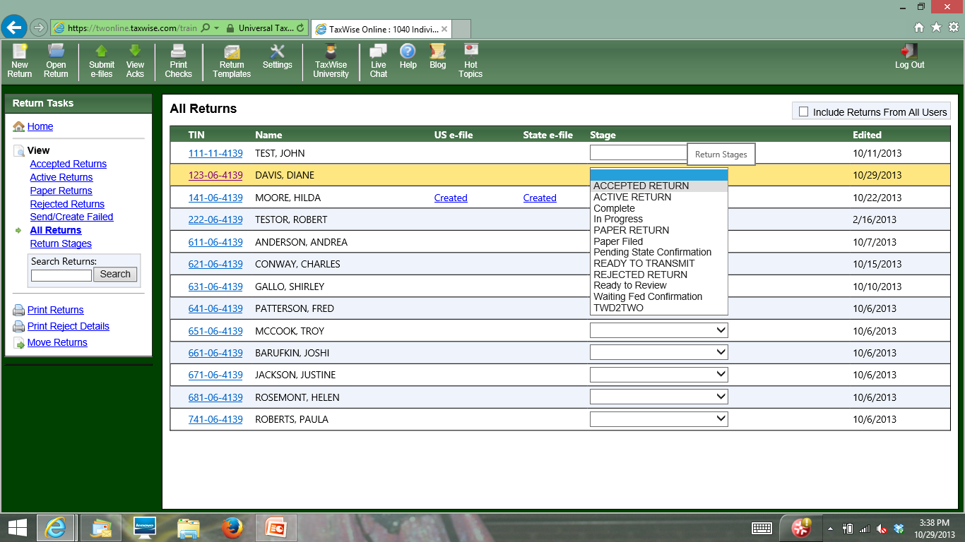
Return Stages on Main Listing Screen
Notes:
In some districts, ERO does not want counselors to use Return Stages. It is reserved for ERO use only
4

Slide 5
Return Stages in E-File Status Section of Return Summary
Notes:
In some districts, ERO does not want counselors to use Return Stages. It is reserved for ERO use only
5

Slide 6
Finalizing Return with Taxpayer
Pub 4012 Tab K
Review printed return with taxpayer
Ask taxpayer to check spelling on names, SSNs, and address on top of 1040.
Review line by line Federal & NJ 1040s
Highlight any carry-overs or “issues”
Have taxpayer(s) sign Form 8879 IRS E-File Signature Authorization
Inform taxpayers they are responsible for return
If joint return, BOTH taxpayers MUST sign
Signatures acknowledge they know they are responsible for return and also gives permission to e-file
Assemble packet for taxpayer in envelope
Return all source documents, Intake/Interview sheet, signed 8879
Notes:
Emphasize that there is a rule that we must inform taxpayers they are responsible for return
Read paragraph from 8879
6

Slide 7
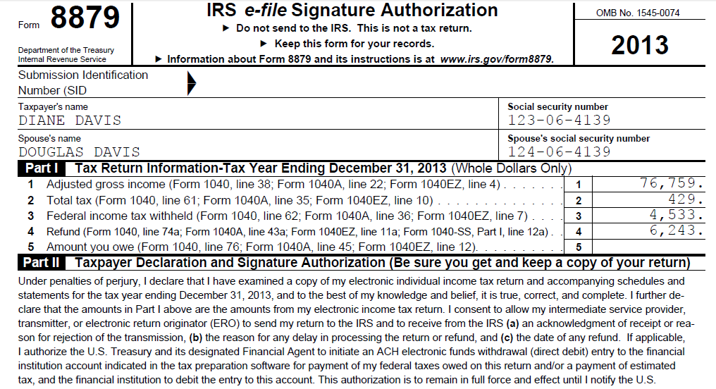
TW IRS e-file Signature Authorization - Form 8879
2014
Inform taxpayers they are responsible for return
Notes:
Taxpayer & Spouse must both sign Form 8879
Inform taxpayers they are responsible for accuracy of return
Not just signing to allow e-filing
Do not need to keep copy of 8879 or Federal copy of W-2s & 1099s to give to ERO
8879 is given back to taxpayer(s) in envelope
7

Slide 8
Power of Attorney (POA)
Pub 4012 Tab K
Required if someone other than taxpayer is signing return
POA must include authority for tax returns
Click on Add Forms; select Form 2848 (POA)
Check box at top, “using this form” (will blue check Form 8453 to show 2848 attached)
Fill in info about representative (Line 2)
List “Type” as Income Tax Return (Line 3)
Check box to retain taxpayer’s original POA (Line 6)
Fill in red lines on 2848, Part II, Declaration
Copy of POA to be attached to Form 8453 Transmittal Form for site to send to IRS
Mail after e-file return is accepted
Notes:
Check the client’s Power of Attorney document to make sure it covers Tax Returns.
A “General Power of Attorney” permits the agent to conduct every kind of business or financial transaction.
A “Limited Power of Attorney” permits the agent to perform a specific act or acts
Also check the dates on the Power of Attorney are active.
8

Slide 9
Refunds/Balance Due
Pub 4012 Tabs 13 & 14
Discuss expected date/method of refund
Review payment alternatives if balance due
Can e-file now & pay by 4/15 with payment voucher (1040-V)
Discuss how to avoid balance due in future
Increase withholdings from wages (W-4)
Request withholding from pension, SS, broker
Estimated tax payments
Assist with Form 1040-ES
Notes:
9

Slide 10
The Last Word
Explain what will happen next
Site responsibility
Taxpayer’s responsibility
Ask taxpayer if any questions
Reminder taxpayer to bring current year tax envelope with them next year;
Ask taxpayer to refer friends to program
Thank taxpayer for coming
Notes:
10

